Slide 1


Guide for FurniturePro Sales & Customer Insights Analysis

Slide 2
Dashboard Pages
Executive Summary
Segment, Category & Region Analysis
Sales Performance
Overall Analysis
Target & Benchmark Analysis
What – if
Pareto Analysis
Customer Analysis
Customer Overview
Customer Segmentation (RFM)
Customer Acquisition & Sales

Slide 3
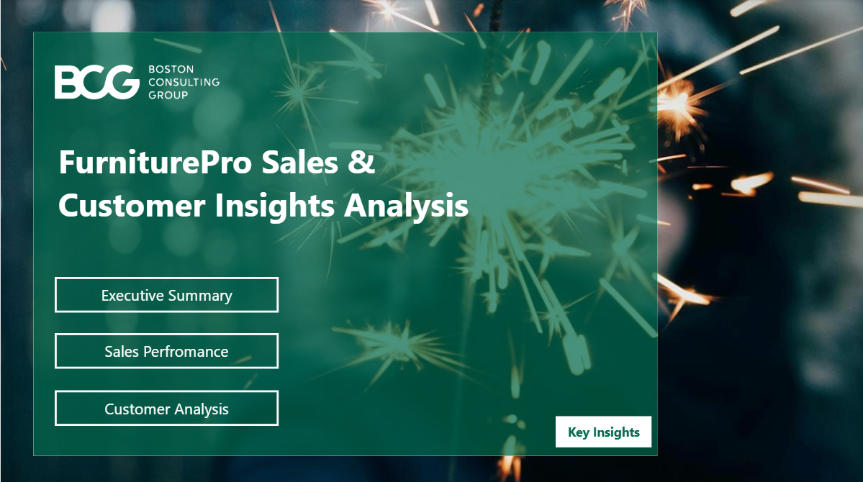
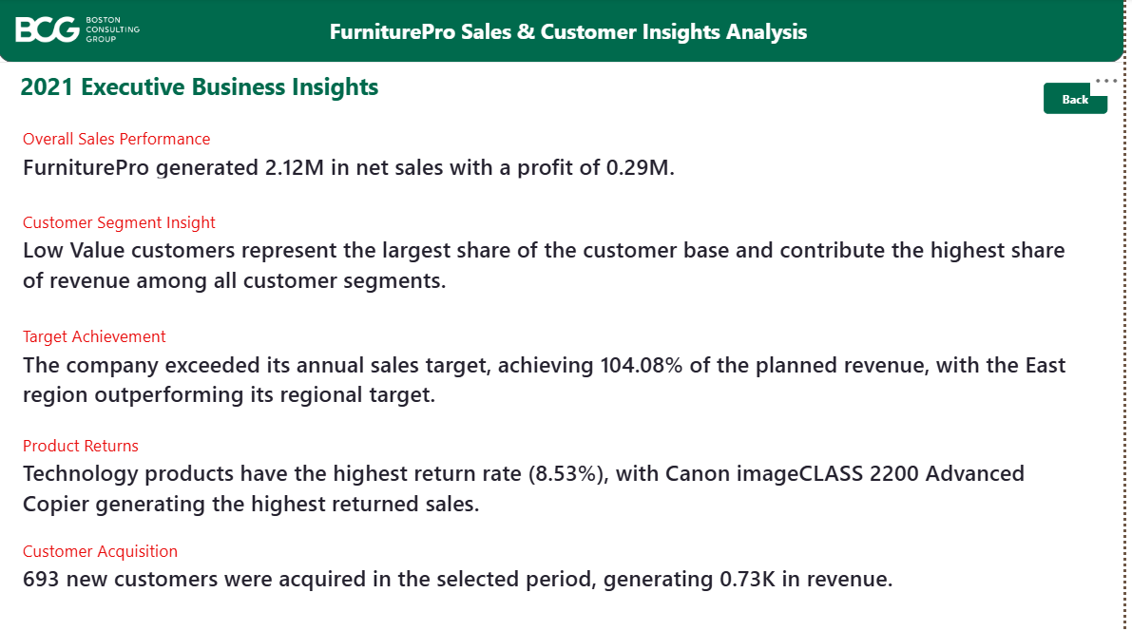
Landing Page
Go to Executive Summary
Insights for 2021- year end meeting
Go to Sales Performance Analysis
Go to Customer Analysis

Slide 4
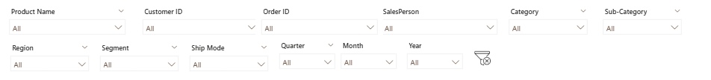
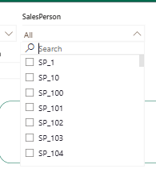
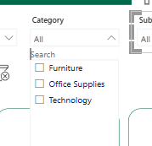
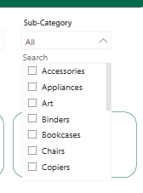
Filter Options (1/2)
Selections based Product Name, Customer ID, Order ID, Sales person
Selections Category and Sub-category

Slide 5
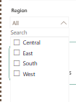





Filter Options (2/2)
Selections based Region, Segment, Ship Mode
Selections Quarter, Month, Year

Slide 6
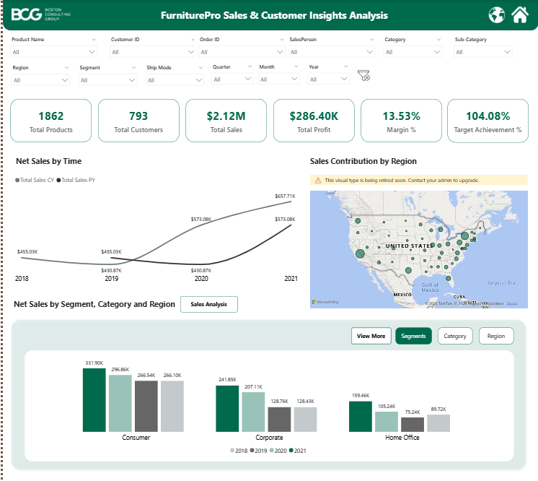
Sales – Executive Insights
Region Analysis & Home
Sales Performance Analysis
View More – Expands the analysis to show additional sales breakdown and deeper insights.

Slide 7
Sales – Executive Insights
Sales – Summary
Objective
Provide an overview of overall sales performance, including revenue, profit, and customers.
Enable region-wise and segment-wise analysis of sales.
Track sales trends over time to understand performance changes.
Identify top contributing customer segments and regions.
Key Insights
Total Net Sales: 2.12M generated from 793 customers and 1862 products.
Profit margin is 12.47%, showing stable profitability.
Return rate is 8.53%, indicating potential improvement areas.
Consumer segment contributes the highest sales compared to Corporate and Home Office.
Sales trend shows a decline after 2020, suggesting a slowdown in demand.
Business Benefits
Helps identify top-performing segments and regions quickly.
Helps track sales trends and performance changes over time.
Supports better sales and product strategy decisions.

Slide 8
Sales – Executive Insights
Page Overview – Sales
1. KPI Cards
Total Products – Number of products sold across all categories.
Total Customers – Total unique customers generating sales.
Total Sales ($) – Overall revenue generated from product sales.
Total Profit ($) – Total profit earned from sales.
Margin (%) – Profitability percentage across all sales.
Target Achievement (%) – Comparison of actual sales against the target.
2. Net Sales Trend
Shows year-wise sales performance from 2018–2021.
Compares current year sales with previous year performance.
Helps identify growth trends and changes in demand over time.
3. Regional Sales Contribution
Displays sales distribution across different regions using a map.
Helps identify high-performing and low-performing geographic markets.
4. Segment & Category Performance
Shows Net Sales distribution across customer segments (Consumer, Corporate, Home Office).
Allows comparison of segment-wise sales across multiple years.
Helps identify which customer segment contributes most to revenue.
5. Interactive Filters
Filters for Product, Customer, Category, Sub-Category, Region, Segment, Ship Mode, Quarter, Month, and Year.
Enables dynamic exploration of sales performance across different dimensions.

Slide 9
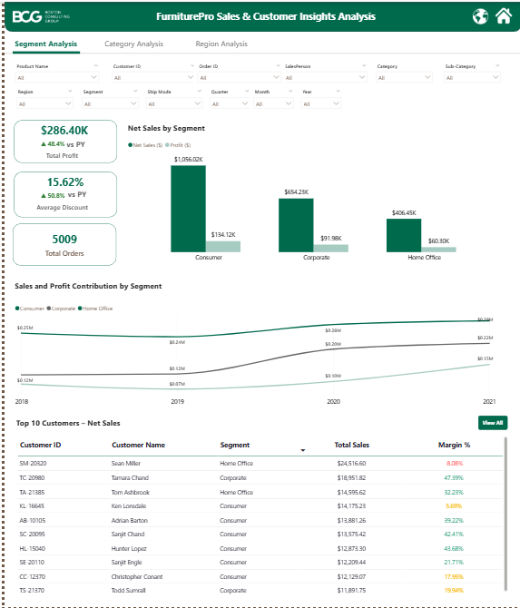
Sales – Executive Insights – View More
Click on “View more”

Slide 10

View More – Segment Analysis
. KPI Cards
Total Profit ($) – Displays total profit generated from all customer segments.
Average Discount (%) – Shows the average discount applied across sales transactions.
Total Orders – Total number of orders placed by customers.
2. Net Sales by Segment
Compares Net Sales and Profit across customer segments (Consumer, Corporate, Home Office).
Helps identify which customer segment contributes the most revenue.
3. Sales & Profit Trend by Segment
Shows sales and profit performance over time (2018–2021) for each segment.
Helps track segment growth patterns and profitability trends.
4. Top Customers Analysis
Displays Top 10 customers based on Net Sales.
Includes Customer Name, Segment, Total Sales, and Margin %.
Helps identify high-value customers contributing the most revenue.

Slide 11
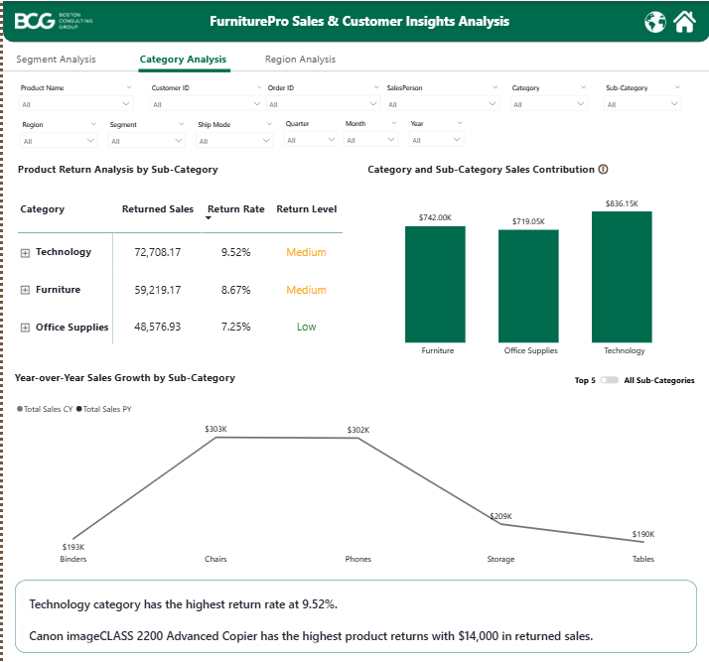
View More – Category Analysis
Product Return Analysis
Shows returned sales and return rate by product category (Technology, Furniture, Office Supplies).
Categorizes return levels (Low / Medium) to quickly identify problem areas.
2. Category Sales Contribution
Displays total sales contribution by product category.
Helps identify which category generates the most revenue.
3. Sub-Category Sales Growth
Shows year-over-year sales performance by sub-category (Binders, Chairs, Phones, Storage, Tables).
Helps identify top-performing and declining product groups.
4. Key Insights

Slide 12
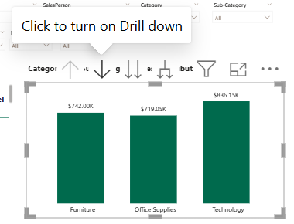
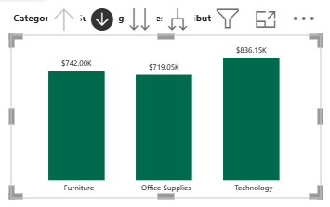
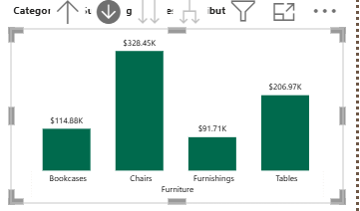
View More – Category Analysis
Click on “Drill down”
Click on “Bar Chart”
Click on “Any of the Category”
Preview of all the subcategories

Slide 13
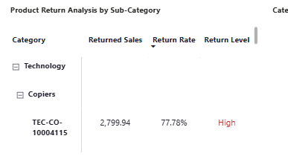
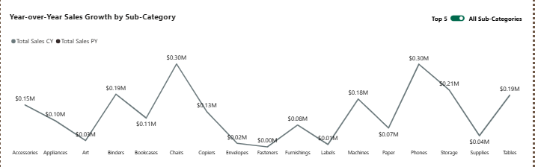
View More – Category Analysis
Category
Subgategory
Products
Click on “+”
Click on “Top 5”

Slide 14
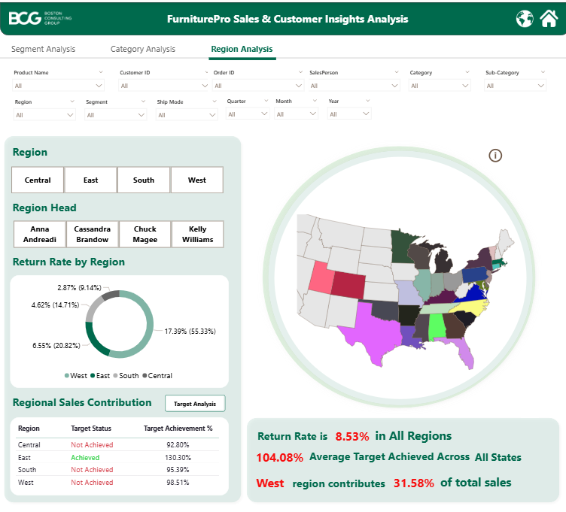
View More – Region Analysis
Region Selection
Allows users to analyse sales performance by region (Central, East, South, West).
Helps compare regional sales and operational performance.
2. Region Head
Displays the responsible manager for each region.
Helps track regional accountability and performance ownership.
3. Return Rate by Region
Shows return percentage across regions.
Helps identify regions with higher product return levels.
4. Regional Sales Contribution
Displays target achievement status for each region.
Helps monitor regional sales performance against targets.
5. Geographic Sales Distribution
Map visualization showing sales presence across different states.
Helps identify high-performing and underperforming locations.

Slide 15
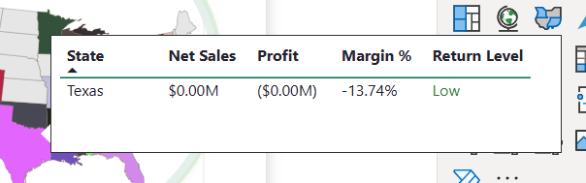
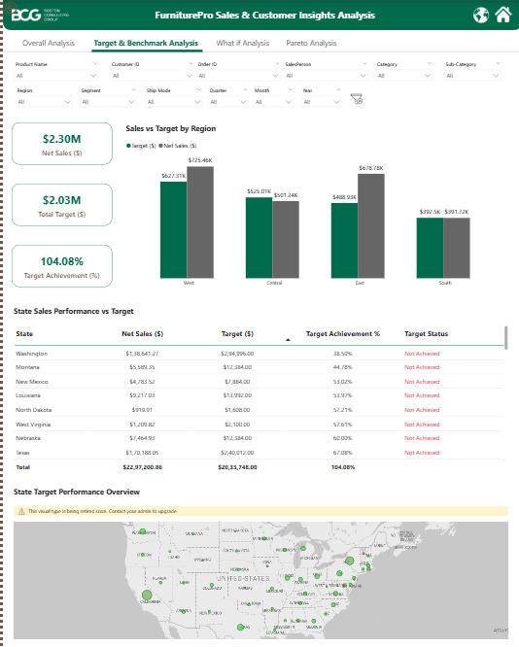
View More – Region Analysis
Hover on
Click on “Target Analysis”

Slide 16
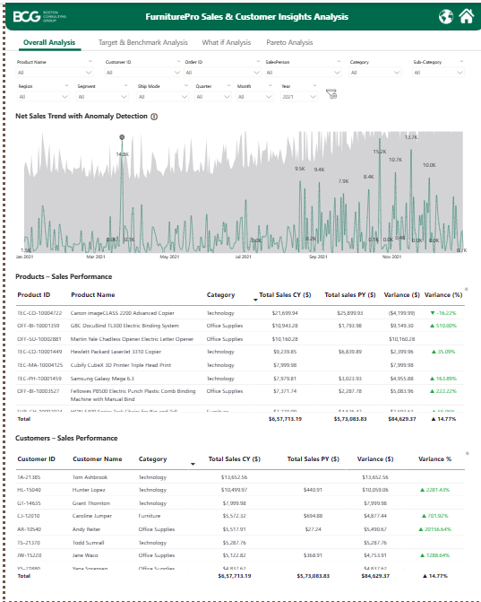
Sales Performance – Overall Analysis
PY sales are displayed only when a specific year filter is applied.
Net Sales Trend with Anomaly Detection
Displays daily net sales trend over time.
Highlights sales spikes and unusual patterns (anomalies) that may indicate promotions, demand surges, or operational issues.
2. Product Sales Performance
Shows top products based on total sales.
Compares current year sales vs previous year sales.
Displays variance and growth percentage to identify high-performing products.
3. Customer Sales Performance
Highlights top customers contributing to revenue.
Compares current year vs previous year customer sales.
Helps identify key customers driving growth and profitability.
4. Performance Comparison
Calculates sales variance between current and previous year.
Helps track business growth and identify performance improvements or declines.

Slide 17
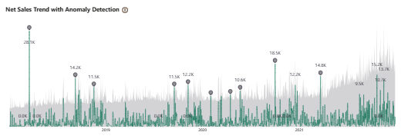
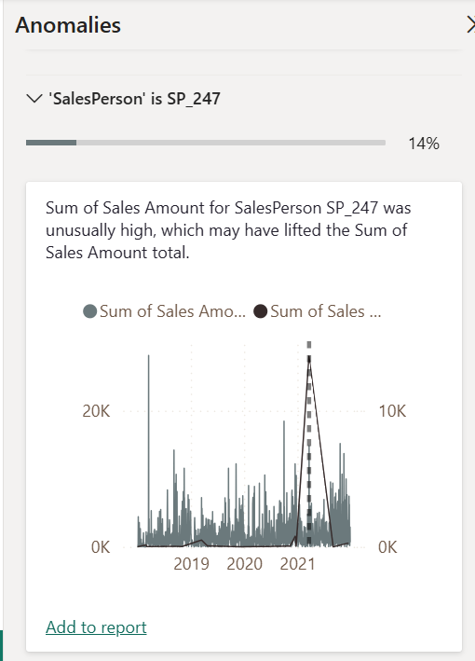
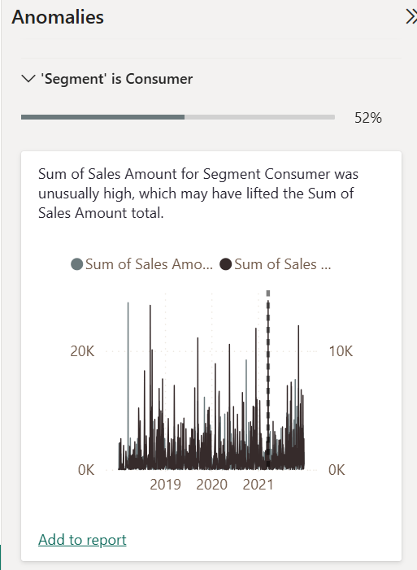
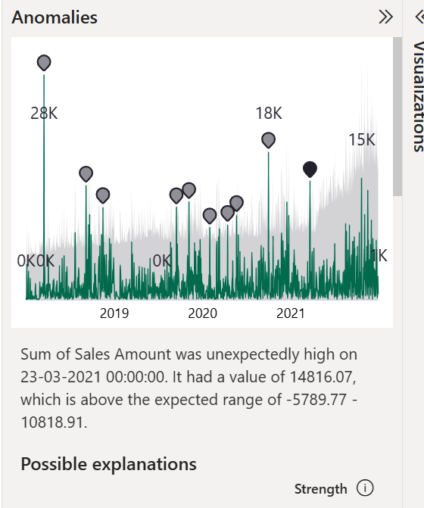
Sales Performance – Overall Analysis
Click on a specific Anomaly for Analysis

Slide 18
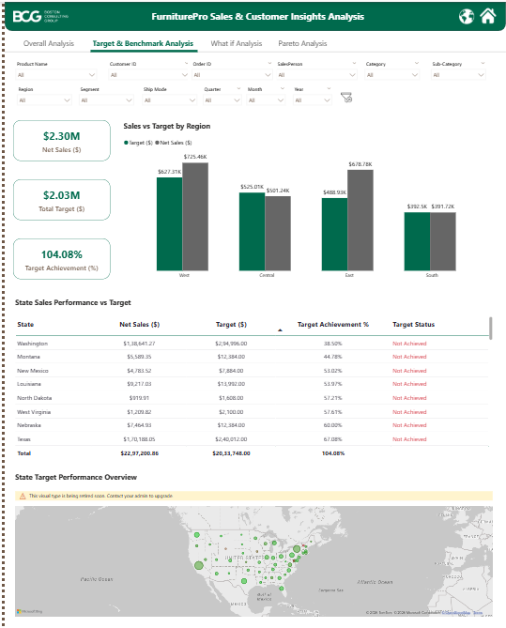
Sales Performance – Target & Benchmark Analysis
1. KPI Cards
Net Sales ($) – Total revenue generated across all regions.
Total Target ($) – Overall sales target set for the selected period.
Target Achievement (%) – Percentage of target achieved based on actual sales.
2. Sales vs Target by Region
Compares actual sales with target values across regions (West, Central, East, South).
Helps identify regions that are meeting or falling short of sales targets.
3. State Sales Performance vs Target
Displays state-level comparison of net sales against targets.
Shows target achievement percentage and status (Achieved / Not Achieved).
Helps identify underperforming states that require attention.
4. Geographic Target Performance
Map visualization showing state-wise sales performance and distribution.
Helps identify regional sales concentration and performance gaps.
5. Performance Insight
Provides overall comparison between total sales and target values to measure business performance.
Helps evaluate how effectively sales targets are being achieved across regions and states.

Slide 19
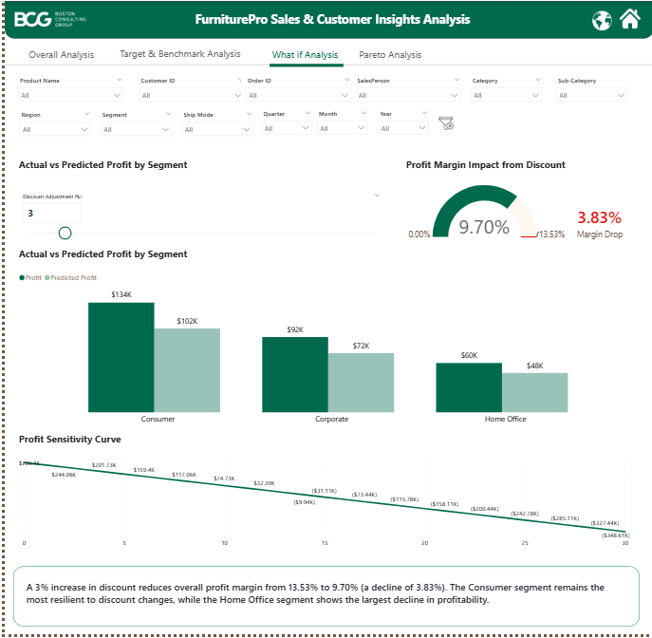
Sales Performance – What if Analysis
1. Discount Adjustment
Allows users to simulate different discount levels using a slider.
Helps analyze how changes in discounts impact profitability.
2. Profit Margin Impact
Displays overall profit margin after applying the selected discount change.
Highlights the percentage drop in margin caused by increased discounts.
3. Actual vs Predicted Profit by Segment
Compares current profit with predicted profit after discount adjustments.
Shows impact across Consumer, Corporate, and Home Office segments.
4. Profit Sensitivity Curve
Shows how profit changes as discount levels increase.
Helps identify the point where higher discounts start reducing profitability significantly.

Slide 20
Sales Performance – What if Analysis
Users can enter or adjust discount % to simulate pricing scenarios. Dashboard dynamically updates predicted profit and margin impact.

Slide 21
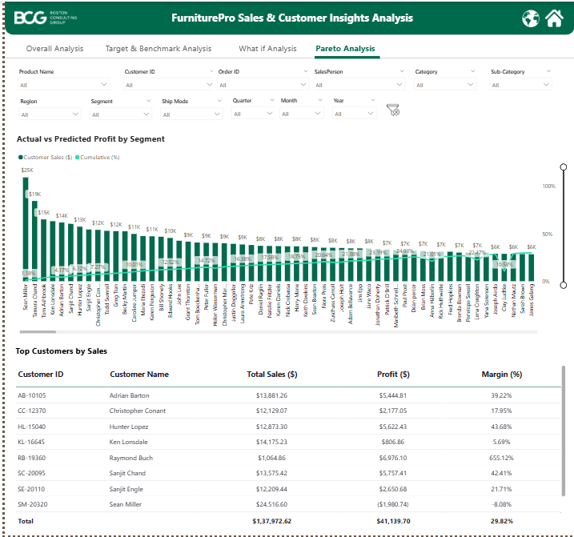
Sales Performance – Pareto Analysis
1. Customer Sales Contribution (Pareto Chart)
Displays customer-wise sales contribution ranked from highest to lowest.
Includes cumulative percentage line to identify the customers driving most of the revenue.
Helps apply the 80/20 Pareto principle to identify high-value customers.
2. Top Customers by Sales
Lists top customers contributing to total sales.
Includes Customer ID, Customer Name, Total Sales, Profit, and Margin %.
Helps identify key customers generating the majority of revenue and profit.

Slide 22
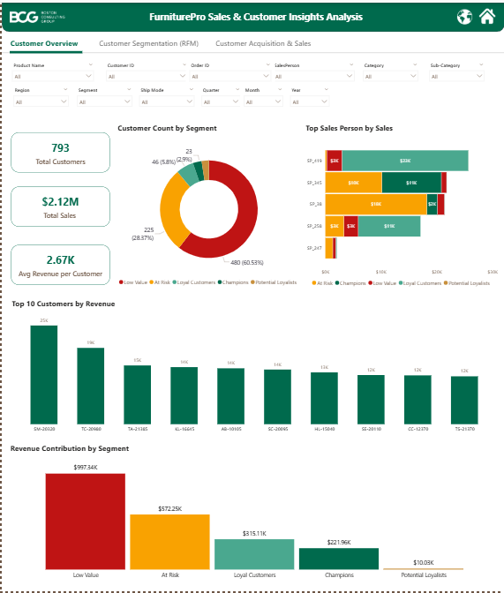
Customer Analysis - Overview
1. KPI Cards
Total Customers – Displays the total number of unique customers.
Total Sales ($) – Total revenue generated from all customers.
Average Revenue per Customer – Average revenue contribution per customer.
2. Customer Count by Segment
Shows distribution of customers across RFM segments (Low Value, At Risk, Loyal Customers, Champions, Potential Loyalists).
Helps understand customer base composition and engagement levels.
3. Top Salesperson by Sales
Displays sales performance of top salespersons.
Shows sales contribution by different customer segments handled by each salesperson.
4. Top Customers by Revenue
Identifies top 10 customers contributing the highest revenue.
Helps highlight key customers driving overall sales performance.
5. Revenue Contribution by Segment
Shows revenue generated by each customer segment.
Helps identify which customer groups contribute the most revenue and where retention strategies are needed.

Slide 23
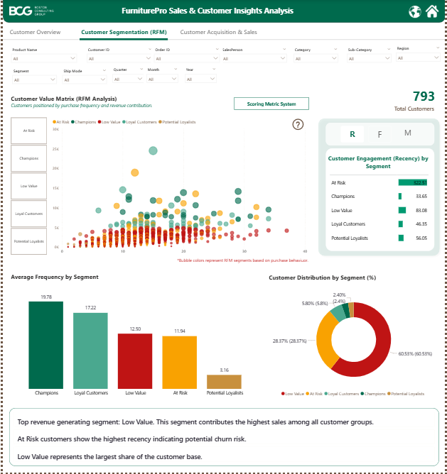
Customer Analysis – Customer Segmentation (RFM)
1. Customer Value Matrix (RFM Analysis)
Visualizes customers based on Recency, Frequency, and Monetary value.
Bubble colors represent different RFM segments such as Champions, Loyal Customers, At Risk, and Low Value.
2. Customer Engagement (Recency) by Segment
Displays average recency score for each customer segment.
Helps identify segments with declining engagement or potential churn risk.
3. Average Frequency by Segment
Shows purchase frequency across customer segments.
Helps identify highly engaged and repeat-purchase customers.
4. Customer Distribution by Segment
Displays percentage distribution of customers across RFM segments.
Helps understand customer base composition and segment size.

Slide 24
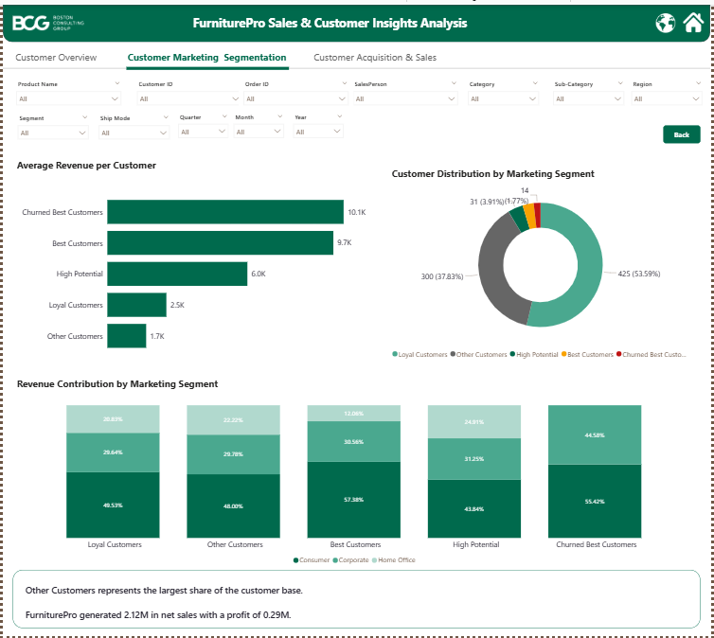
Customer Analysis – Customer Segmentation (RFM)
Scoring Metric System (Bonus)

Slide 25
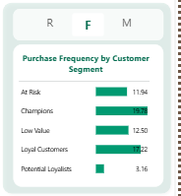
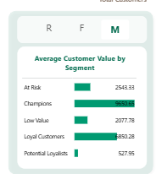
Customer Analysis – Customer Segmentation (RFM)
Toggle between R, F, and M to view detailed customer insights for each metric.
Enables focused analysis of customer engagement, purchase frequency, and revenue contribution.

Slide 26
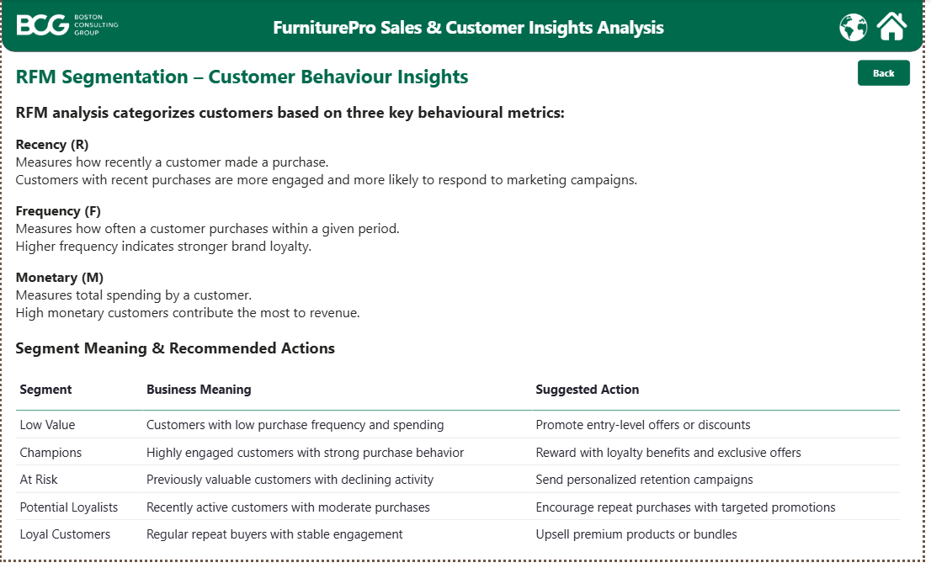
Customer Analysis – Customer Segmentation (RFM)
Slicers

Slide 27
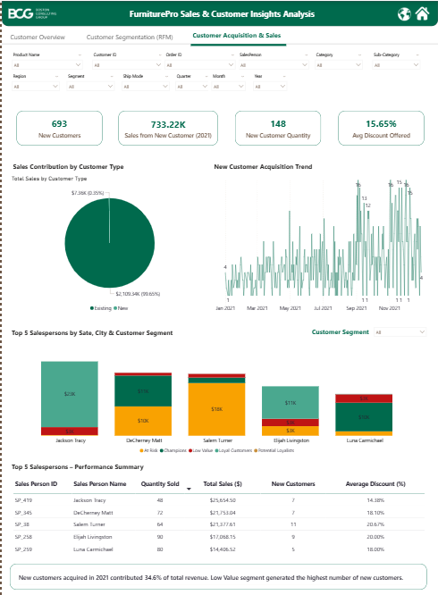
Customer Analysis – Customer Acquisition & Sales
1. KPI Cards
New Customers – Total number of newly acquired customers.
Sales from New Customers ($) – Revenue generated from newly acquired customers.
New Customer Quantity – Total orders placed by new customers.
Average Discount Offered (%) – Average discount provided to new customers.
2. Sales Contribution by Customer Type
Displays revenue share between existing and new customers.
Helps understand how much revenue is driven by newly acquired customers.
3. New Customer Acquisition Trend
Shows trend of new customer acquisition over time.
Helps identify growth patterns and acquisition spikes during the year.
4. Top Salespersons by Sales
Highlights top-performing salespersons based on sales contribution.
Shows their sales distribution across different customer segments.
5. Salesperson Performance Summary
Provides a detailed comparison of top salespersons.
Includes quantity sold, total sales, new customers acquired, and average discount offered.

Slide 28
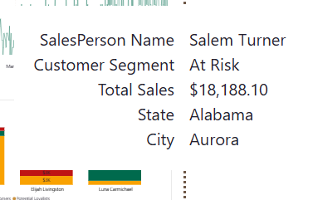
Customer Analysis – Customer Acquisition & Sales
Hover on

